Slide 1
Chapter 17: Additional aspects of Aqueous Equilibria
Dr. Aimée Tomlinson
Chem
1212

Slide 2
Section 17.1
Common-Ion Effect

Slide 3
Common Ions
When two different species give rise to the same ion
  I.E. both NaCl & HCl give rise to Cl-
  Placing NaCl in HCl will repress the dissociation of the acid

Slide 4
Common-Ion Effect
Defn: a shift based on equilibrium due to the addition of a common ion
It is based on Le Châtelier’s Principle
Example:
  Adding HCO₃⁻ will shift the eq to the left
  As a consequence less H₃O⁺ is produced
  The pH is higher than it would have been

Slide 5

Common-Ion Effect Example
Calculate the pH of a solution prepared by mixing equal volumes of 0.20 M CH₃NH₂ and 0.60 M CH₃NH₃Cl (K_{b} = 3.7 x 10⁻⁴). What is the pH of 0.20 M CH₃NH₂ without addition of CH₃NH₃Cl?

Slide 6
Section 17.2
Buffer Solutions

Slide 7
pH Buffer
A solution that resists changes in pH
Generated from an acid with its conjugate base or a base with its conjugate acid pair
Overall it is the result of the common-ion effect

Slide 8
Forming Good Buffers
Need a large buffer capacity: the quantity of acid/base needed to significantly change the pH of a buffer
Two ways to make a good buffer:
  Equal volumes – where more concentrated solutions will give rise to a larger capacity
  Equal moles – where larger volumes will give rise to larger capacities

Slide 9
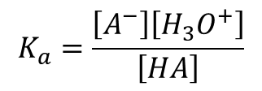

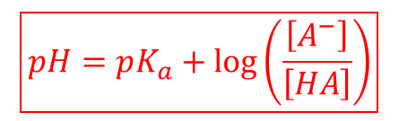
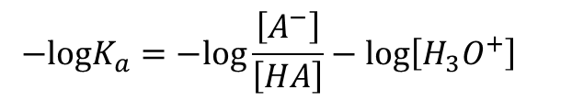
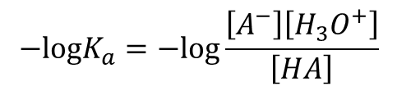
Henderson-Hasselbalch Equation
This is how we figure out how to make our buffers
$$HA+H_{2}O⇌A^{−}+H_{3}O^{+}$$
$$K_{a}=\frac{\left[A^{−}\right]\left[H_{3}O^{+}\right]}{\left[HA\right]}$$
$$−logK_{a}=−log\frac{\left[A^{−}\right]\left[H_{3}O^{+}\right]}{\left[HA\right]}$$
$$−logK_{a}=−log\frac{\left[A^{−}\right]}{\left[HA\right]}−log\left[H_{3}O^{+}\right]$$
$$\boxed{pH=pK_{a}+log\left(\frac{\left[A^{−}\right]}{\left[HA\right]}\right)}$$

Slide 10
Buffer Example I
Calculate the pH and pOH of a 500.0 mL solution containing 0.225 M HPO₄⁻² and 0.225M PO₄⁻³ at 25⁰C where K_{a}(HPO₄⁻²)= 4.2 x 10⁻¹³.

Slide 11
Buffer Example II
How would we prepare a pH = 4.44 buffer using CH₃CO₂H and CH₃CO₂Na (K_{a} = 1.8 x 10⁻⁵)?

Slide 12
Comprehensive Example
This set of questions will include questions from both Chapter 16 & Chapter 17
Determine the pH for each of the following:
a.) 0.100 M HC₃H₅O₂ with K_{a} = 1.3 x 10⁻⁵
b.) 0.100 M NaC₃H₅O₂
c.) Mixture of a.) and b.)
d.) Mixture of c.) with 0.020 mol NaOH
e.) Mixture of c.) with 0.020 mol HCl

Slide 13
Part a.)
0.100 M HC₃H₅O₂ with K_{a} = 1.3 x 10⁻⁵

Slide 14
Part b.)
0.100 M NaC₃H₅O₂ with K_{a} = 1.3 x 10⁻⁵

Slide 15
Part c.)
0.100 M HC₃H₅O₂ & 0.100 M NaC₃H₅O₂ with K_{a} = 1.3 x 10⁻⁵

Slide 16
Part d.)
0.100 M HC₃H₅O₂ & 0.100 M NaC₃H₅O₂ & 0.020 mol NaOH with K_{a} = 1.3 x 10⁻⁵

Slide 17
Part e.)
0.100 M HC₃H₅O₂ & 0.100 M NaC₃H₅O₂ & 0.020 mol HCl with K_{a} = 1.3 x 10⁻⁵

Slide 18
Comprehensive Example
Putting it all together:
Determine the pH for each of the following:
a.) 0.100 M HC₃H₅O₂ with K_{a} = 1.3 x 10⁻⁵ pH = 2.96
b.) 0.100 M NaC₃H₅O₂ pH = 8.94
c.) Mixture of a.) and b.) pH = 4.89
d.) Mixture of c.) with 0.020 mol NaOH pH = 5.06
e.) Mixture of c.) with 0.020 mol HCl pH = 4.71
X 4

Slide 19
Sections 17.3
Acid-Base Titrations

Slide 20
Four Types of Neutralization
Strong Acid + Strong Base
Strong Acid + Weak Base
Always lead to neutral solution
Salt is present but as spectator ions
Always lead to acidic solution
Only anion of acid is a spectator ion
Weak Acid + Strong Base
Weak Acid + Weak Base
Always lead to basic solution
Only cation of base is a spectator ion
Must compare K_{a} & K_{b} to determine pH
There are no spectator ions

Slide 21
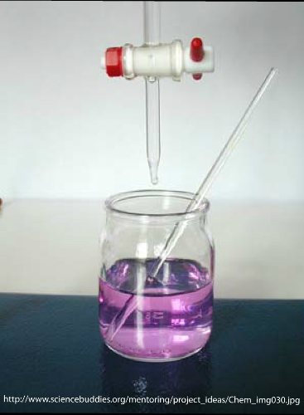

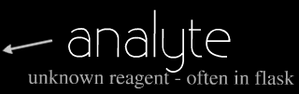
Titration
Used to determine the concentration of an unknown

Slide 22
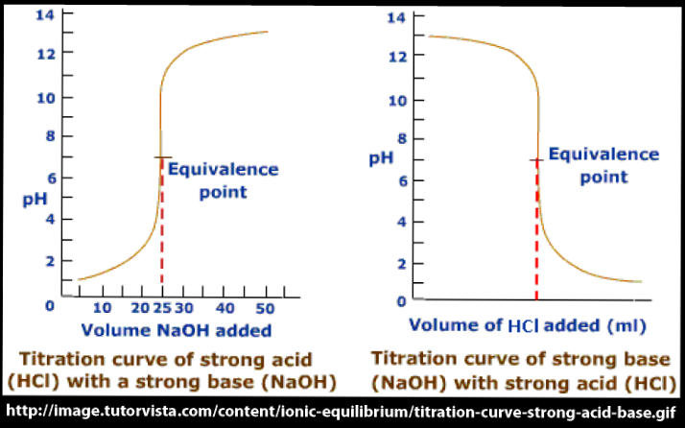
Titration Curve
A plot of pH versus volume of titrant

Slide 23
Equivalence Point
Point at which moles of acid = moles of base
Strong acid with weak base: pH < 7.0 acidic
Strong acid with strong base: pH = 7.0 neutral
Weak acid with strong base: pH > 7.0 basic

Slide 24
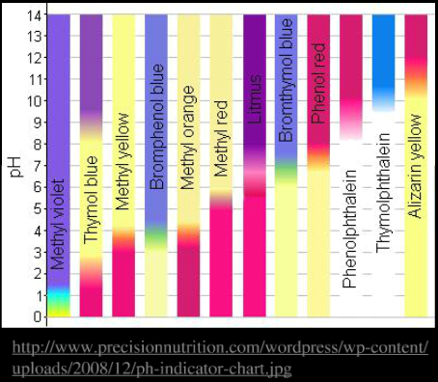
pH Indicators
Change color at the equivalence point
Strong acid with weak base
thymol blue
Strong acid with strong base
phenolphthalein
Weak acid with strong base
alizarin yellow

Slide 25
Titration Example I
What is [NH₃] if 22.35mL of 0.1145 M HCl were needed to titrate a 100.0mL sample?

Slide 26
Titration Example II
Strong with Strong: A 15.0 mL sample of 0.200 M NaOH is titrated with 0. 250 M of HCl. Calculate the pH of the mixture after 10.0, and 20.0 mL of acid have been added.

Slide 27
Titration Example II
Strong with Strong: A 15.0 mL sample of 0.200 M NaOH is titrated with 0. 250 M of HCl. Calculate the pH of the mixture after 10.0, and 20.0 mL of acid have been added.

Slide 28
Titration Example III
Strong with Weak: A 25.0 mL sample of 0.100 M acetic acid (HC₂H₃O₂) is titrated with 0.125 M of NaOH. Calculate the pH of the mixture after 0.0,10.0, 20.0, and 30.0 mL of base have been added. (K_{a} = 1.8 x 10⁻⁵)

Slide 29
Titration Example III
Strong with Weak: A 25.0 mL sample of 0.100 M acetic acid (HC₂H₃O₂) is titrated with 0.125 M of NaOH. Calculate the pH of the mixture after 0.0,10.0, 20.0, and 30.0 mL of base have been added. (K_{a} = 1.8 x 10⁻⁵)

Slide 30
Titration Example III
Strong with Weak: A 25.0 mL sample of 0.100 M acetic acid (HC₂H₃O₂) is titrated with 0.125 M of NaOH. Calculate the pH of the mixture after 0.0,10.0, 20.0, and 30.0 mL of base have been added. (K_{a} = 1.8 x 10⁻⁵)

Slide 31
Titration Example III
Strong with Weak: A 25.0 mL sample of 0.100 M acetic acid (HC₂H₃O₂) is titrated with 0.125 M of NaOH. Calculate the pH of the mixture after 0.0,10.0, 20.0, and 30.0 mL of base have been added. (K_{a} = 1.8 x 10⁻⁵)
X 2

Slide 32
Section 17.4
Solubility Equilibria

Slide 33
Solubility Product
It is the equilibrium constant for solids in solution, K_{sp}
An actual example looks like:

Slide 34
Solubility Example
Determine the equilibrium concentrations (and solubilities) of BaF_{2(s)}, K_{sp} = 1.7x10⁻⁶.
X 2

Slide 35
Section 17.5
Factors that Affect Solubility

Slide 36
Three Solubility Factors
Common-Ion Effect
pH
Complex ion formation – we are skipping this one

Slide 37
Common-Ion Solubility Example
Calculate the solubility of calcite (CaCO₃) in 0.00100 M of Na₂CO₃ and in just plain water (K_{sp} = 4.5x10⁻⁹ at 25°C).

Slide 38
pH Solubility Example
If the salt added possesses a conjugate acid or conjugate base then pH will impact the solubility of the salt
Addition of acid will pull carbonate out of the solution
Recall LCP when we remove product the eq will push forward
This leads to more CaCO₃ being dissolved
Overall this trend demonstrates why so many compounds are more soluble in acidic solutions
X 2

Slide 39
Sections 17.6-17.7
SKIP!

